Slide 1
CM1605 Web Technology
CSS – Cascading Style Sheets
Week 3 | Janani Harischandra

Slide 2
Learning Outcomes
Covers LO2 for Module Descriptor
On completion of this lecture, students are expected to be able to:
Understand the concepts of cascading style sheets, CSS syntax,, CSS Box Model, Pseudo Classes & Elements, CSS selectors, CSS Positioning
Describe how CSS files work and give examples of CSS formatting tags.
Understand and apply different ways of using CSS in hypertext documents.

Slide 3
Content
Introduction to CSS
CSS Syntax : Property & Values
CSS Formatting Tags
How to use CSS
CSS Selectors
CSS Pseudo Classes & Elements
CSS Box Model
How CSS files Cascade
Positioning with CSS
CSS files validation & CSS3

Slide 4
CSS – Cascading Style Sheets
CSS allows you to create rules that specify how the content of an element should appear.
CSS is used to define styles for your web pages, including the design, layout and variations in display for different devices and screen sizes.
The separation of HTML from CSS makes
Easier to maintain sites
Share style sheets across pages
Tailor pages to different environments
Reliable browser support
Layout controls
CSS saves a lot of work. It can control the layout of multiple web pages all at once.

Slide 5
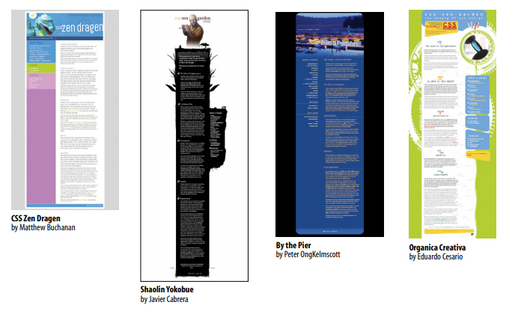
Power of CSS
All of these designs use the exact same HTML source document. but the design is changed using exclusively CSS (used with permission of CSS Zen Garden and the individual designers).

Slide 6
CSS Syntax
CSS works by associating rules with HTML elements.
These rules govern how the content of specified elements should be displayed.
A CSS rule contains two parts: a selector and a declaration.
Selectors
Indicate which element the rule applies to.
The same rule can apply to more than one element if you separate the element names with commas.
Declarations
Indicate how the elements referred to in the selector should be styled.
Declarations are split into two parts (a property and a value), and are separated by a colon.

Slide 7
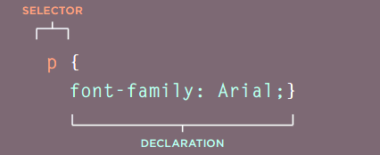
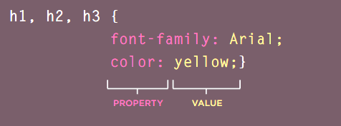
CSS Syntax

Slide 8
CSS Property and Values
Properties indicate the aspects of the element you want to change.
Values specify the settings you want to use for the chosen properties.
Eg:
text-align : center;
color : black;
font-family : arial;
font-size : 12px;

Slide 9
CSS Formatting Categories
Color – Background, Font
Position
Size
Alignment
Margins
Text
Borders

Slide 10
How to use CSS
When a browser reads a style sheet, it will format the HTML document according to the information in the style sheet.
There are three ways to insert a style sheet.
Inline style
Internal style sheet
External style sheet

Slide 11

Inline style
An inline style is usually used to apply a unique style for a single HMTL element.
The style attribute is used to add style to the relevant element.
The style attribute can contain any CSS property.
An inline style loses many of the advantages of a style sheet (by mixing content with presentation).
Eg:

Slide 12
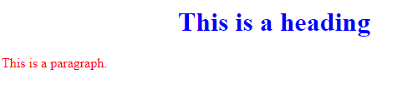
Inline Style
HTML Markup | Formatted Text
<!DOCTYPE html> <html> <body> <h1 style="color:blue;text-align:center;">This is a heading</h1> <p style="color:red;">This is a paragraph.</p> </body> </html>

Slide 13
Internal/embedded Style Sheets
An internal style sheet may be used if one single HTML page has a unique style.
Inline style sheets are difficult to modify. Discuss why?
The internal style is defined inside the <style> element, inside the head section.
HTML5 only requires style for the opening tag of an embedded style sheet.

Slide 14
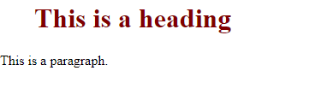
Internal Style Sheet Example
HTML Markup | Formatted Text
<!DOCTYPE html> <html> <head> <style> h1 { color: maroon; margin-left: 40px; } </style> </head> <body> <h1>This is a heading</h1> <p>This is a paragraph.</p> </body> </html>

Slide 15
CSS Selectors
CSS selectors are used to "find" (or select) the HTML elements you want to style.
Element Selector
Selects HTML elements based on the element name
ID Selector
Uses the id attribute of an HTML element
Class Selector
Universal Selector
Selects HTML elements with a specific class attribute
Selects all HTML elements on the page (*)
Grouping Selector
Selects all the HTML elements with the same style definitions

Slide 16
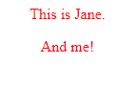
CSS Element Selector
HTML Markup | Formatted Text
<!DOCTYPE html> <html> <head> <style> p { text-align: center; color: red; } </style> </head> <body> <p> This is Jane.</p> <p>And me!</p> </body> </html>

Slide 17

CSS ID Selector
HTML Markup | Formatted Text
<!DOCTYPE html> <html> <head> <style> #para1 { text-align: center; color: red; } </style> </head> <body> <p id="para1">Hello World</p> <p>Hi.</p> </body> </html>

Slide 18

CSS Class Selector
HTML Markup | Formatted Text
<!DOCTYPE html> <html> <head> <style> .center { text-align: center; color: red; } </style> </head> <body> <h1 class="center">Red and center-aligned heading</h1> </body> </html>

Slide 19
External Style Sheet
When building a website there are several advantages to placing your CSS rules in a separate style sheet.
All of the web pages can share the same style sheet.
This is achieved by using the <link> element on each HTML page of the site to link to the same CSS document.
Each page must include a link to the style sheet with the <link> tag. The <link> tag goes inside the head section.
Why External CSS ? Discuss
Less code
Faster loading
Easy to modify
Uniform formatting

Slide 20
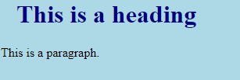
External Style Sheet Example
HTML Markup | Formatted Text
<!DOCTYPE html> <html> <head> <link rel="stylesheet" type="text/css" href="mystyle.css"> </head> <body> <h1>This is a heading</h1> <p>This is a paragraph.</p> </body> </html>

Slide 21
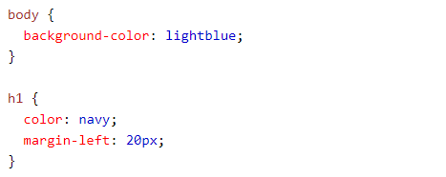
External CSS Files
An external style sheet can be written in any text editor, and must be saved with a .css extension.
The external .css file should not contain any HTML tags.
Here is how the "mystyle.css" file looks like:

Slide 22
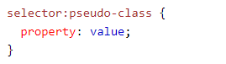
CSS Pseudo Classes
There are three pseudo-classes that allow you to change the appearance of elements when a user is interacting with them.
A pseudo-class is used to define a special state of an element. Eg:
Style an element when a user mouses over it
Style visited and unvisited links differently
Style an element when it gets focus
Syntax

Slide 23

CSS Pseudo Elements
A CSS pseudo-element is used to style specified parts of an element. Eg:
Style the first letter, or line, of an element
Insert content before, or after, the content of an element
Syntax

Slide 24
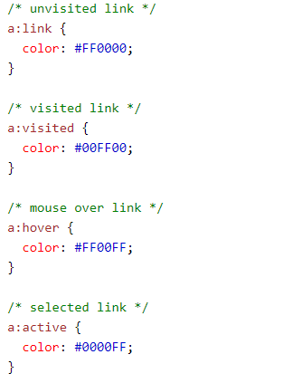



CSS Pseudo Classes/Elements Example

Slide 25
Styling Tables
HTML Markup | CSS
<table> <caption>My First Table</caption> <tr class="b"> <th colspan="2">Col 1</th> </tr> <tr> <td rowspan="2">Cell 1</td><td>Cell 2</td> </tr> <tr class="a"> <td>Cell 4</td> </tr> </table> | <style> table,td,th{ border-collapse: collapse; border: 2px dashed blue; } td{ padding:10px;} th{text-align:left;} .a{background-color:#D0FFFF;} .b{background-color:#FFFFD0} </style>

Slide 26

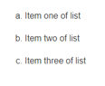
Styling Lists
HTML Markup | CSS
<ol> <li>AAA</li> <li>XXX</li> <li>YYY</li> </ol> <ul> <li>Pete</li> <li>Jane</li> <li>Rex</li> </ul> | <style> ol{ list-style-type:square } ul{ list-style-type:lower-alpha } </style>

Slide 27
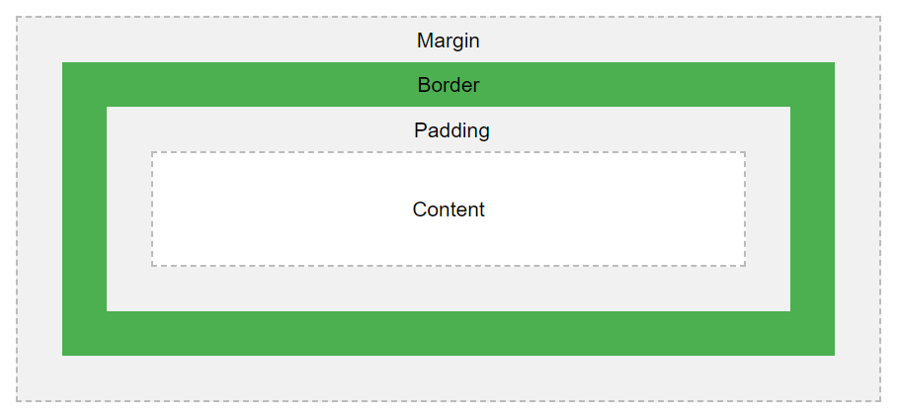
CSS Box Model
All HTML elements can be considered as boxes.
The CSS box model is essentially a box that wraps around every HTML element.
It consists of:
Margins
Borders
Padding
Actual content

Slide 28
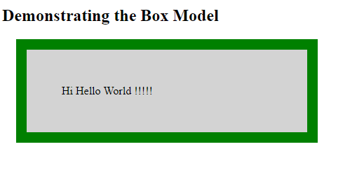
CSS Box Model Example
HTML Markup | Formatted Text
<!DOCTYPE html> <html> <head> <style> div { background-color: lightgrey; width: 300px; border: 15px solid green; padding: 50px; margin: 20px; } </style> </head> <body> <h2>Demonstrating the Box Model</h2> <div>Hi Hello World !!!!!</div> </body> </html> | What is this total width <div> element ?
300px (width) + 100px (left + right padding) + 30px (left + right border) + 40px (left + right margin) = 470px

Slide 29
How CSS Cascade?
What style will be used when there is more than one style specified for an HTML element?
All the styles in a page will "cascade" into a new "virtual" style sheet by the following rules, where number one has the highest priority:
Inline style (inside an HTML element)
External and internal style sheets (in the head section)
Inline style has the highest priority, and will override external and internal styles.

Slide 30
CSS Positioning
CSS has the positioning schemes that allow to control the position of,
Layouts of pages
Images
The float property is used for positioning and formatting.
The float property can be used to wrap text around images.
The float property can have following values:
Float:left
Float:right
Float:none - defualt
Float:inherit

Slide 31
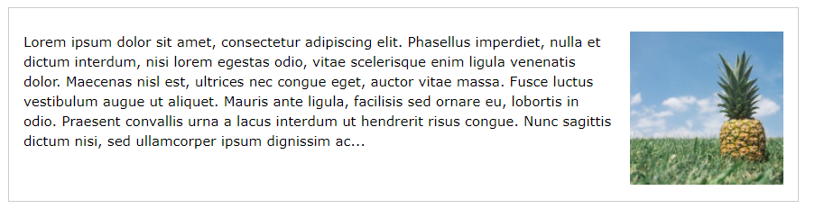

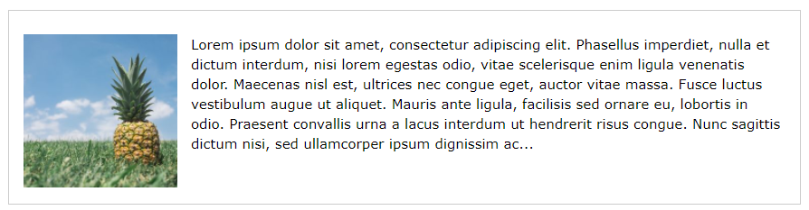

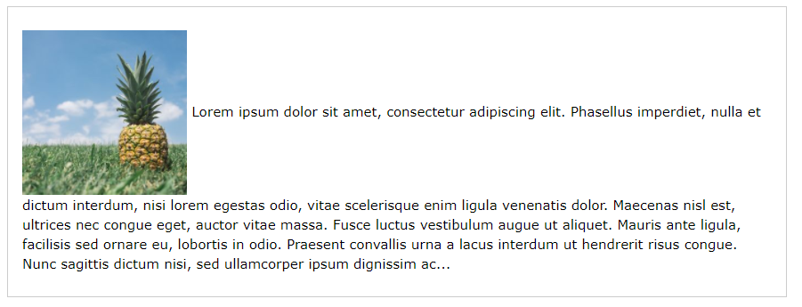

Floating Images

Slide 32
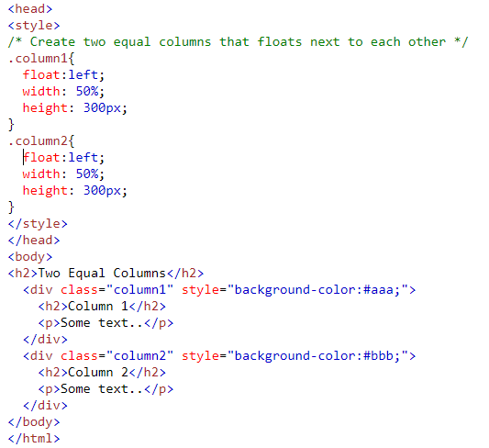
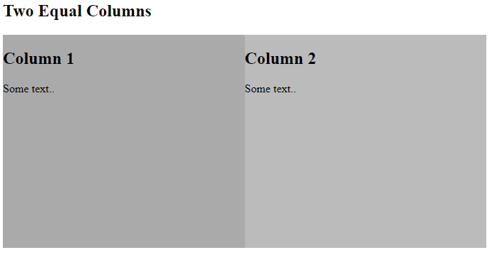
Floating Layouts
There are two layouts approaches available
Liquid Layouts with percentage
Fixed Layouts with pixels

Slide 33
CSS3
CSS3 is the latest version of the CSS specification.
The CSS3 specification is still under development.
However, many of the new CSS3 properties have been implemented in modern browsers.
CSS3 adds several new styling features and improvements to enhance the web presentation capabilities.

Slide 34
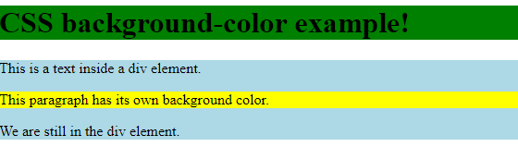
Review Questions
What tag is used to link to an external style sheet?
How do you define and use a CSS class?
What is the difference between padding and margin?
Write a CSS code to display following

Slide 35
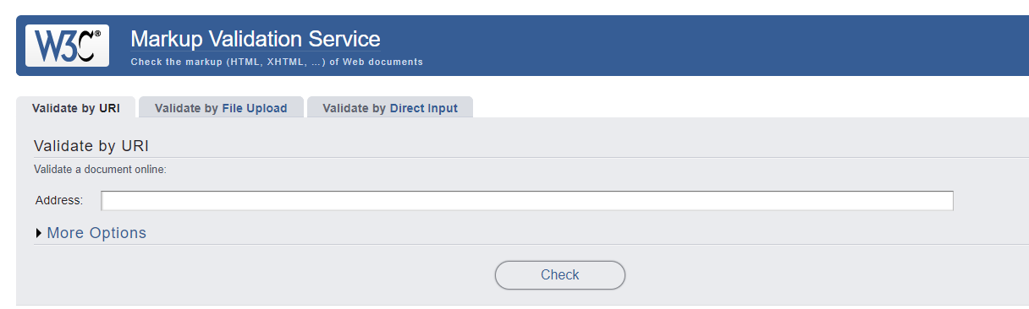
CSS Validators

Slide 36
READING
Duckett, J. (2011), HTML & CSS, Design and Build Websites, Wiley.
Robbinson, J . (2018), Learning Web Design, A Beginner’s Guide to HTML,CSS, JavaScript, And Web Graphics, O’Reilly.
Castro & Hyslop, B.(2011), HTML5&CSS: Visual QuickStart Guide, Peachpit Press.
Online :
https://www.w3schools.com/css/default.asp

